Slide 1
IS Ratings x TNFD Requirements
Navigating Nature-Based Disclosures in the Infrastructure Sector I Dec 11, 2024
Notes:
Somerset

Slide 2
Agenda
1
What is TNFD – The emerging “nature” of ESG reporting requirements Ross Eaton, Partner, Oliver Wyman
TNFD – Implications for the Infrastructure Sector Monique Isenheim, Head of Market Development, ISC
2
IS Ratings & TNFD - Alignment
Kerry Griffiths, IS Technical Director, ISC
3
IS Ratings & TNFD - Correspondence Map Amin Niazai, Senior Technical Advisor, ISC
4
5
Questions & Answers

Slide 3
Acknowledgement of country
ISC would like to acknowledge the Traditional Custodians of the lands on which we meet today. ​
We acknowledge their deep connection to land, water and culture, and pay our respects to their Elders past, present and future.​
Tēnā koutou katoa to our attendees in New Zealand.​

Slide 4
What is TNFD – The emerging “nature” of ESG reporting requirements Ross Eaton | Partner | Oliver Wyman

Slide 5
Key Messages
Nature risk can translate into financial risks
ESG reporting requirements are evolving to require nature-related disclosures
Nature reporting is likely to be broader and even more challenging than climate reporting, especially for financiers
Notes:
Mention Paulson institute findings: nature is very threatened right now, and on many dimensions the problem is even worse than climate.
Since the global economy is ultimately reliant on nature, this poses a significant risk. For Australian the stat is 50% of GDP reliance on nature, and 80% of exports, including Mining and Agriculture. And so it’s obvious that either eco-system collapse or law preventing further damage could threaten elements of the economy and cause financial risk via the same mechanisms as climate: physical and transition risks.

Slide 6
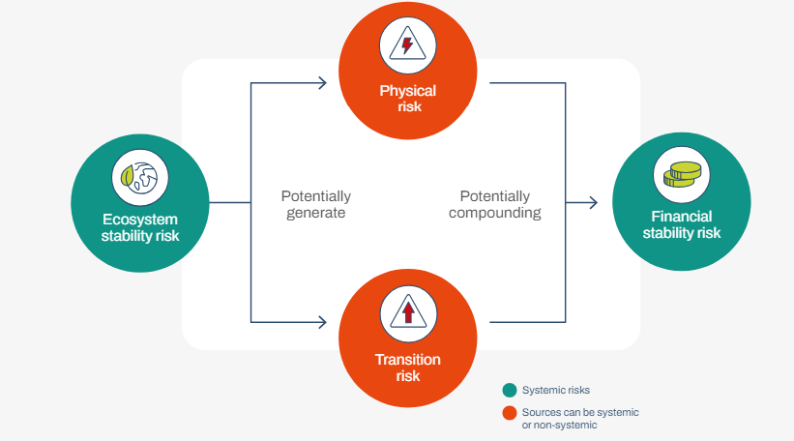
Why does it matter?
Nature risks translate into financial risks
Fig.: Nature-related risk categories. Source: Recommendations of the Taskforce on Nature-related Financial Disclosures, p.36.
Notes:
Mention Paulson institute findings: nature is very threatened right now, and on many dimensions the problem is even worse than climate.
Since the global economy is ultimately reliant on nature, this poses a significant risk. For Australian the stat is 50% of GDP reliance on nature, and 80% of exports, including Mining and Agriculture. And so it’s obvious that either eco-system collapse or law preventing further damage could threaten elements of the economy and cause financial risk via the same mechanisms as climate: physical and transition risks.

Slide 7
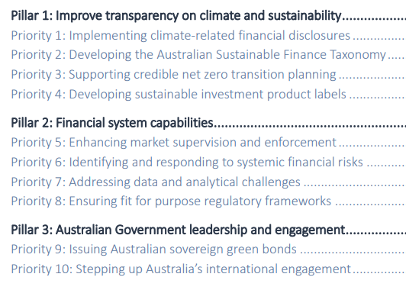
Government Sustainable Finance Strategy
Sustainability linked financial disclosures, regulatory frameworks, and data are priorities in the Australian Government’s Sustainable Finance Strategy
Fig.: Sustainable Finance Roadmap. Source: Treasury, 2024.
Notes:
From Treasurer: Australia is taking a ‘climate first, not only’ approach. You can see that implementing climate related financial disclosures is priority #1, and the government has signalled that it will follow suit if (and seems like a matter of when not if) there are nature related international standards developed.
You may have heard that a nature bill a couple of weeks ago was killed by the prime minister. This included the creation of an EPA and more serious punishments for breaking environmental laws.
Within 7, Nature-related data relevant to understanding financial risks is one of the 4 key topics (others being related to climate)

Slide 8
Emerging ESG reporting requirements
ESG reporting requirements increasingly complement a company’s traditional financial reporting
Global Shift Towards Mandatory Reporting
Governments and regulatory bodies are moving from voluntary ESG reporting to mandatory disclosure requirements. This trend is seen across regions like the EU, the US, and Australia (including AASB S2: Climate-related Disclosures).
Moving from Climate-Related Reporting to broader disclosures
As climate risks reporting has become mandatory in many jurisdictions, there is an increased focus on reporting on broader nature impacts, risks and opportunities.
Consolidation of Frameworks
There is growing momentum towards aligning different ESG reporting frameworks, such as the GRI, ISSB, GBF and TCFD/TNFD, to create consistency in reporting.
Notes:
Mandatory reporting. Governments have largely accepted recommendations of TCFD on climate and adopted those. In many countries including Australia this follows the rules set up the International Sustainability Standards Board, and the AASB standards are included in this.
Expanding beyond climate. ISSB signaled in December 2022 that it intends to draw on the work of the TNFD as and when it develops specific nature-related disclosure standards following the release of its IFRS S1 General Requirements and S2 Climate-related Disclosure Standards in June 2023. Europe already has compulsory nature reporting under the Corporate Sustainability Reporting Directory and are developing European Sustainability Reporting Standards (ESRS).
Finally, we are seeing convergence, which is great for consistency, and so it is likely that the ISSB will essentially determine requirements in Australia, and the ISSB’s standards are highly likely to follow the TNFD requirements closely, as they did the TCFD.

Slide 9
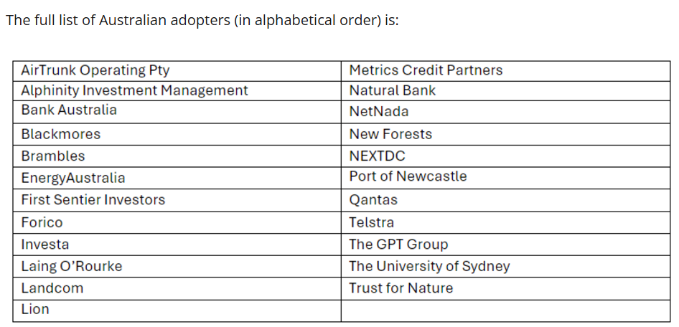
Voluntary adoption in Australia
Several Australian companies have already committed to getting started with voluntary reporting
Fig.: Early Australian TNFD adopters. Source: Recommendations of the Taskforce on Nature-related Financial Disclosures, Oct 2024.
Notes:
As we saw for climate, we’re also seeing some voluntary adoption of the TNFD recommendations.

Slide 10
TNFD Framework Overview
The TNFD’s recommended 14 disclosures for all sectors are structured around four pillars
Governance | Strategy | Risk & impact management | Metrics and targets
Disclose the organisation’s governance of nature-related dependencies, impacts, risks and opportunities (NRDIROs) | Disclose the effects of NRDIROs on the organisation’s business model, strategy and financial planning where such information is material | Describe the processes used by the organisation to identify, assess, prioritise and monitor NRDIROs | Disclose the metrics and targets used to assess and manage material NRDIROs
Board oversight Management role Human rights policies and engagement activities | NRDIROs Impact on business model, value chain, strategy and financial planning Resilience of the organisation’s strategy to nature, taking into consideration different scenarios Locations of assets and/or activities in the organisation’s direct operations and upstream and downstream priority locations | (i) Processes for identifying, assessing and prioritising NRDIROs (ii) Processes for identifying, assessing and prioritising NRDIROs in upstream and downstream value chain(s) Processes for managing NRDIROs Impact on risk management | Metrics to assess and manage material nature-related risks and opportunities Metrics to assess and manage dependencies and impacts on nature Targets and goals
Source: The Taskforce on Nature-Related Climate Disclosures, Oliver Wyman analysis
Notes:
These are applicable for ALL sectors and company sizes.
Nature-related dependencies, impacts, risks and opportunities
Disclosures cover the same four pillars included in the TCFD climate disclosures.
…
Importantly on metrics and targets: dependencies and impacts

Slide 11
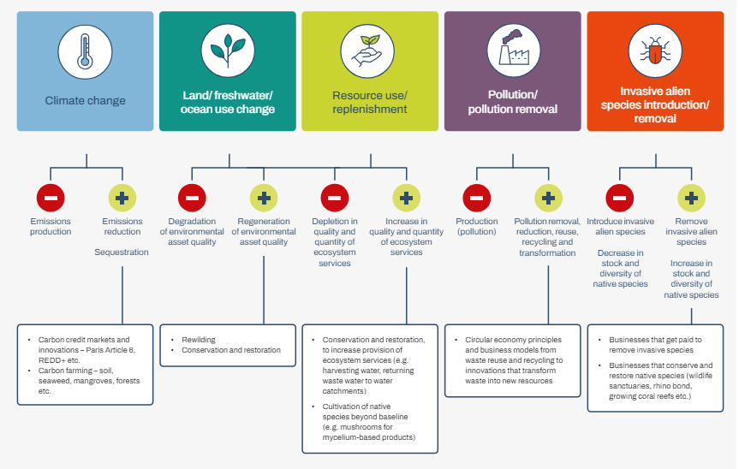
Impact Drivers
A business can have positive or negative impact over 5 key drivers of nature change
Impact drivers are measurable quantities of a natural resource that are used as an input to production and
measurable non-product outputs of a business activity
that affects nature.
An impact pathway describes how, as a result of a
specific business activity, a particular impact driver
can lead to changes in natural capital and flows of ecosystem services, and how these changes affect different stakeholders.
Fig.: Drivers of nature change – reflecting both negative and positive impacts. Source: Recommendations of the Taskforce on Nature-related Financial Disclosures, p.63.
Notes:
Noting what’s good for nature is generally good for climate; but the other way around is not true. E.g. windmills and transition lines, mining for transition minerals.

Slide 12
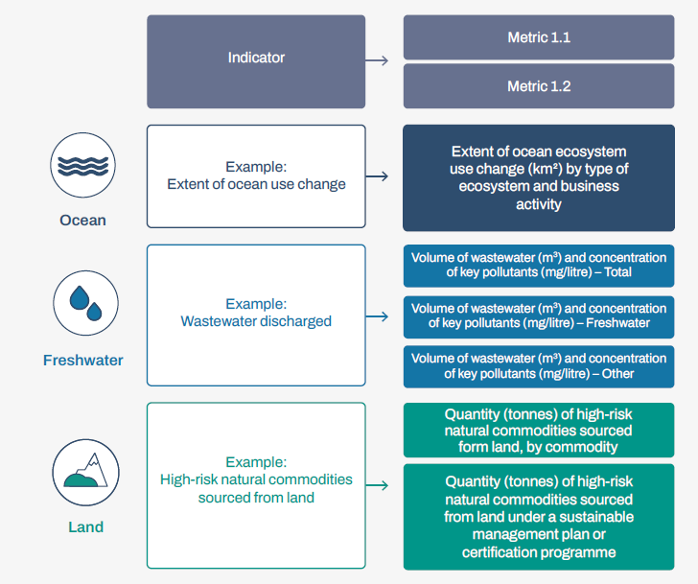
Indicators and Metrics
Indicators and metrics are used to describe and report on a company’s impact on nature
Fig.: Indicators and metrics. Source: Recommendations of the Taskforce on Nature-related Financial Disclosures, p.62.
Notes:
An indicator is a quantitative or qualitative factor or variable that provides a simple and reliable means to measure performance.61 An indicator can be measured through one or multiple metrics. A metric is a system or standard of measurement.62 Metrics for each category should correspond to related indicators in order to create a suite of related indicators across all metrics categories.

Slide 13
Significance of Place Based Reporting
Identification, assessment and management of nature-related issues is necessarily different to climate
“When disclosing information about material nature-related issues by geographic location, the organisation should disaggregate information to the extent possible. Organisations are encouraged to improve the level of geolocation precision over time as data and traceability improve.” p.45
“Climate change is a global process within one shared atmosphere. That essential character has led to the concept of a global carbon budget, which is central to the global policy and business response to address climate change. Nature-related impacts and dependencies, by contrast, are location specific, and therefore require local, context-specific assessment and responses. Understanding where interactions with nature occur is of paramount importance to the identification, assessment and management of nature related issues.” p.14
“Consideration of the geographic location of the organisation’s interfaces with nature (…) should therefore be central to the organisation’s assessment of its nature-related issues, and where material, to its disclosure statements. This is an important difference from the analysis of climate through Scope 1, 2 and 3 emissions.” p.44
Source: The Taskforce on Nature-Related Climate Disclosures

Slide 14
Financiers face particular challenges, especially around data
Financial institutions have the added challenges of being one step removed from most of their risks and impacts
Key themes reported by global financial institutions in 2024
Key data challenges for infrastructure investors
Poor data availability in customers’ disclosures
Available data is typically only at company level, not asset level
Lack of methodology consistency or disclosure inhibits ability to use customer data and increases risks
>50% of institutions have conducted a nature materiality assessment
Institutions doubling down on biodiversity and ecosystem management
Risk quantification remains a bottleneck
Data availability is the most common challenge cited
Source: Oliver Wyman’s 2024 FS Nature Benchmarking survey, Oliver Wyman analysis

Slide 15
TNFD – Implications for the infrastructure Sector Monique Isenheim | Head of Market Development | ISC

Slide 16
Relevance for the infrastructure sector
By aligning with TNFD guidelines, infrastructure companies can identify and manage their risks more effectively and position themselves as leaders in sustainability.
Risk Assessment and Management
Biodiversity Impact
Resource Dependency
Regulatory Risks
2. Financial Reporting and Disclosure
Incorporation of Nature-related Risks
Investor Expectations
3. Strategic Planning and Project Design
Sustainable Infrastructure
Long-term Resilience
4. Stakeholder Engagement
Community Impact
Transparency
5. Compliance and Reporting
Reporting Requirements
Metrics and Data
This requires adequate systems, processes, practices and aligned organisational culture.
Notes:
The TNFD recommendations are designed for organisations of all geographies and sizes- including small and medium size, across all sectors and along value chains, hence includes infrastructure sector
The TNFD requirements have several key implications for the sector:
1. Risk Assessment and Management:
Biodiversity Impact: Infrastructure projects often lead to significant changes in land use, which can affect biodiversity. Under TNFD, companies will need to assess and disclose how their operations impact ecosystems and species.
Resource Dependency: Infrastructure development and operations often depends on natural resources like water, minerals, and timber. TNFD encourages companies to assess how changes in the availability of these resources could affect their projects.
Regulatory Risks: As governments introduce stricter regulations to protect natural environments, infrastructure companies could face increased compliance costs and project delays. TNFD disclosures will need to reflect these risks and how they are managed.
2. Financial Reporting and Disclosure:
Incorporation of Nature-related Risks: Companies in the infrastructure sector will need to include nature-related risks in their financial disclosures. This could affect asset valuations, particularly for projects that are heavily dependent on natural resources and ecosystems services or that impact sensitive environments.
Investor Expectations: Investors are increasingly looking for companies to disclose how they are managing environmental risks. TNFD-aligned reporting could become a key factor in investment decisions, with potential implications for capital costs.
3. Strategic Planning and Project Design:
Sustainable Infrastructure: TNFD requirements create transparency and will drive infrastructure companies to adopt more sustainable practices, such as using better designs, sustainable construction methods and materials, reducing water and energy consumption, and protecting natural habitats.
Long-term Resilience: Infrastructure projects are often long-term investments. TNFD encourages companies to consider the long-term environmental risks that could impact the viability of their assets, such as climate change and loss of ecosystem provisioning services.
4. Stakeholder Engagement:
Community Impact: Infrastructure projects can significantly impact local communities and first nations people, especially those projects that dependent on natural resources. TNFD emphasizes the need for companies to engage with stakeholders to understand and mitigate these impacts.
Transparency: TNFD encourages greater transparency in how companies manage nature-related risks, which could lead to increased interest from NGOs, local communities, and the public.
5. Compliance and Reporting:
Reporting Requirements: Compliance with TNFD will require organisations to build capacity, systems and processes that enable reporting against key nature-related dependencies, impacts, risks and opportunities.
Metrics and Data: Access to and interpretation of high-quality metrics and data is the foundation of accurate reporting. Compared to climate reporting, which is largely focussed on a single aggregated metric, nature-related reporting is considerably more extensive and complex. Due to the localised character of nature-related impact, gaining insights and gathering metrics on a project/asset level is paramount.
In summary, the TNFD framework puts a focus on how the infrastructure sector manages nature-related risks and opportunities. By aligning with TNFD guidelines, companies can identify and manage their risks more effectively and position themselves as leaders in sustainability. However, this requires adequate systems, processes, practices and aligned organisational culture.

Slide 17
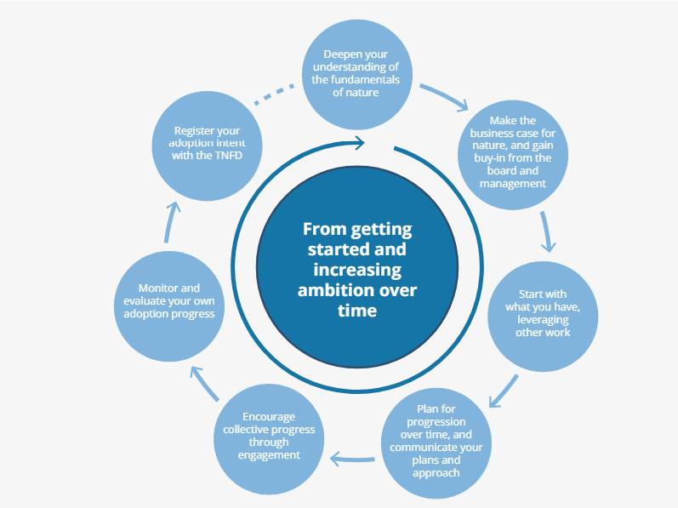
Starting, then getting better
No expectation to fully understand and cover all metrics and targets from the start – sophistication will increase over time
Fig.: Seven key steps to get started and increase TNFD disclosure ambition over time.
Source: Getting started with adoption of the TNFD recommendations p.12.
Notes:
You don’t have to be great to get started but you have to get started to get great

Slide 18
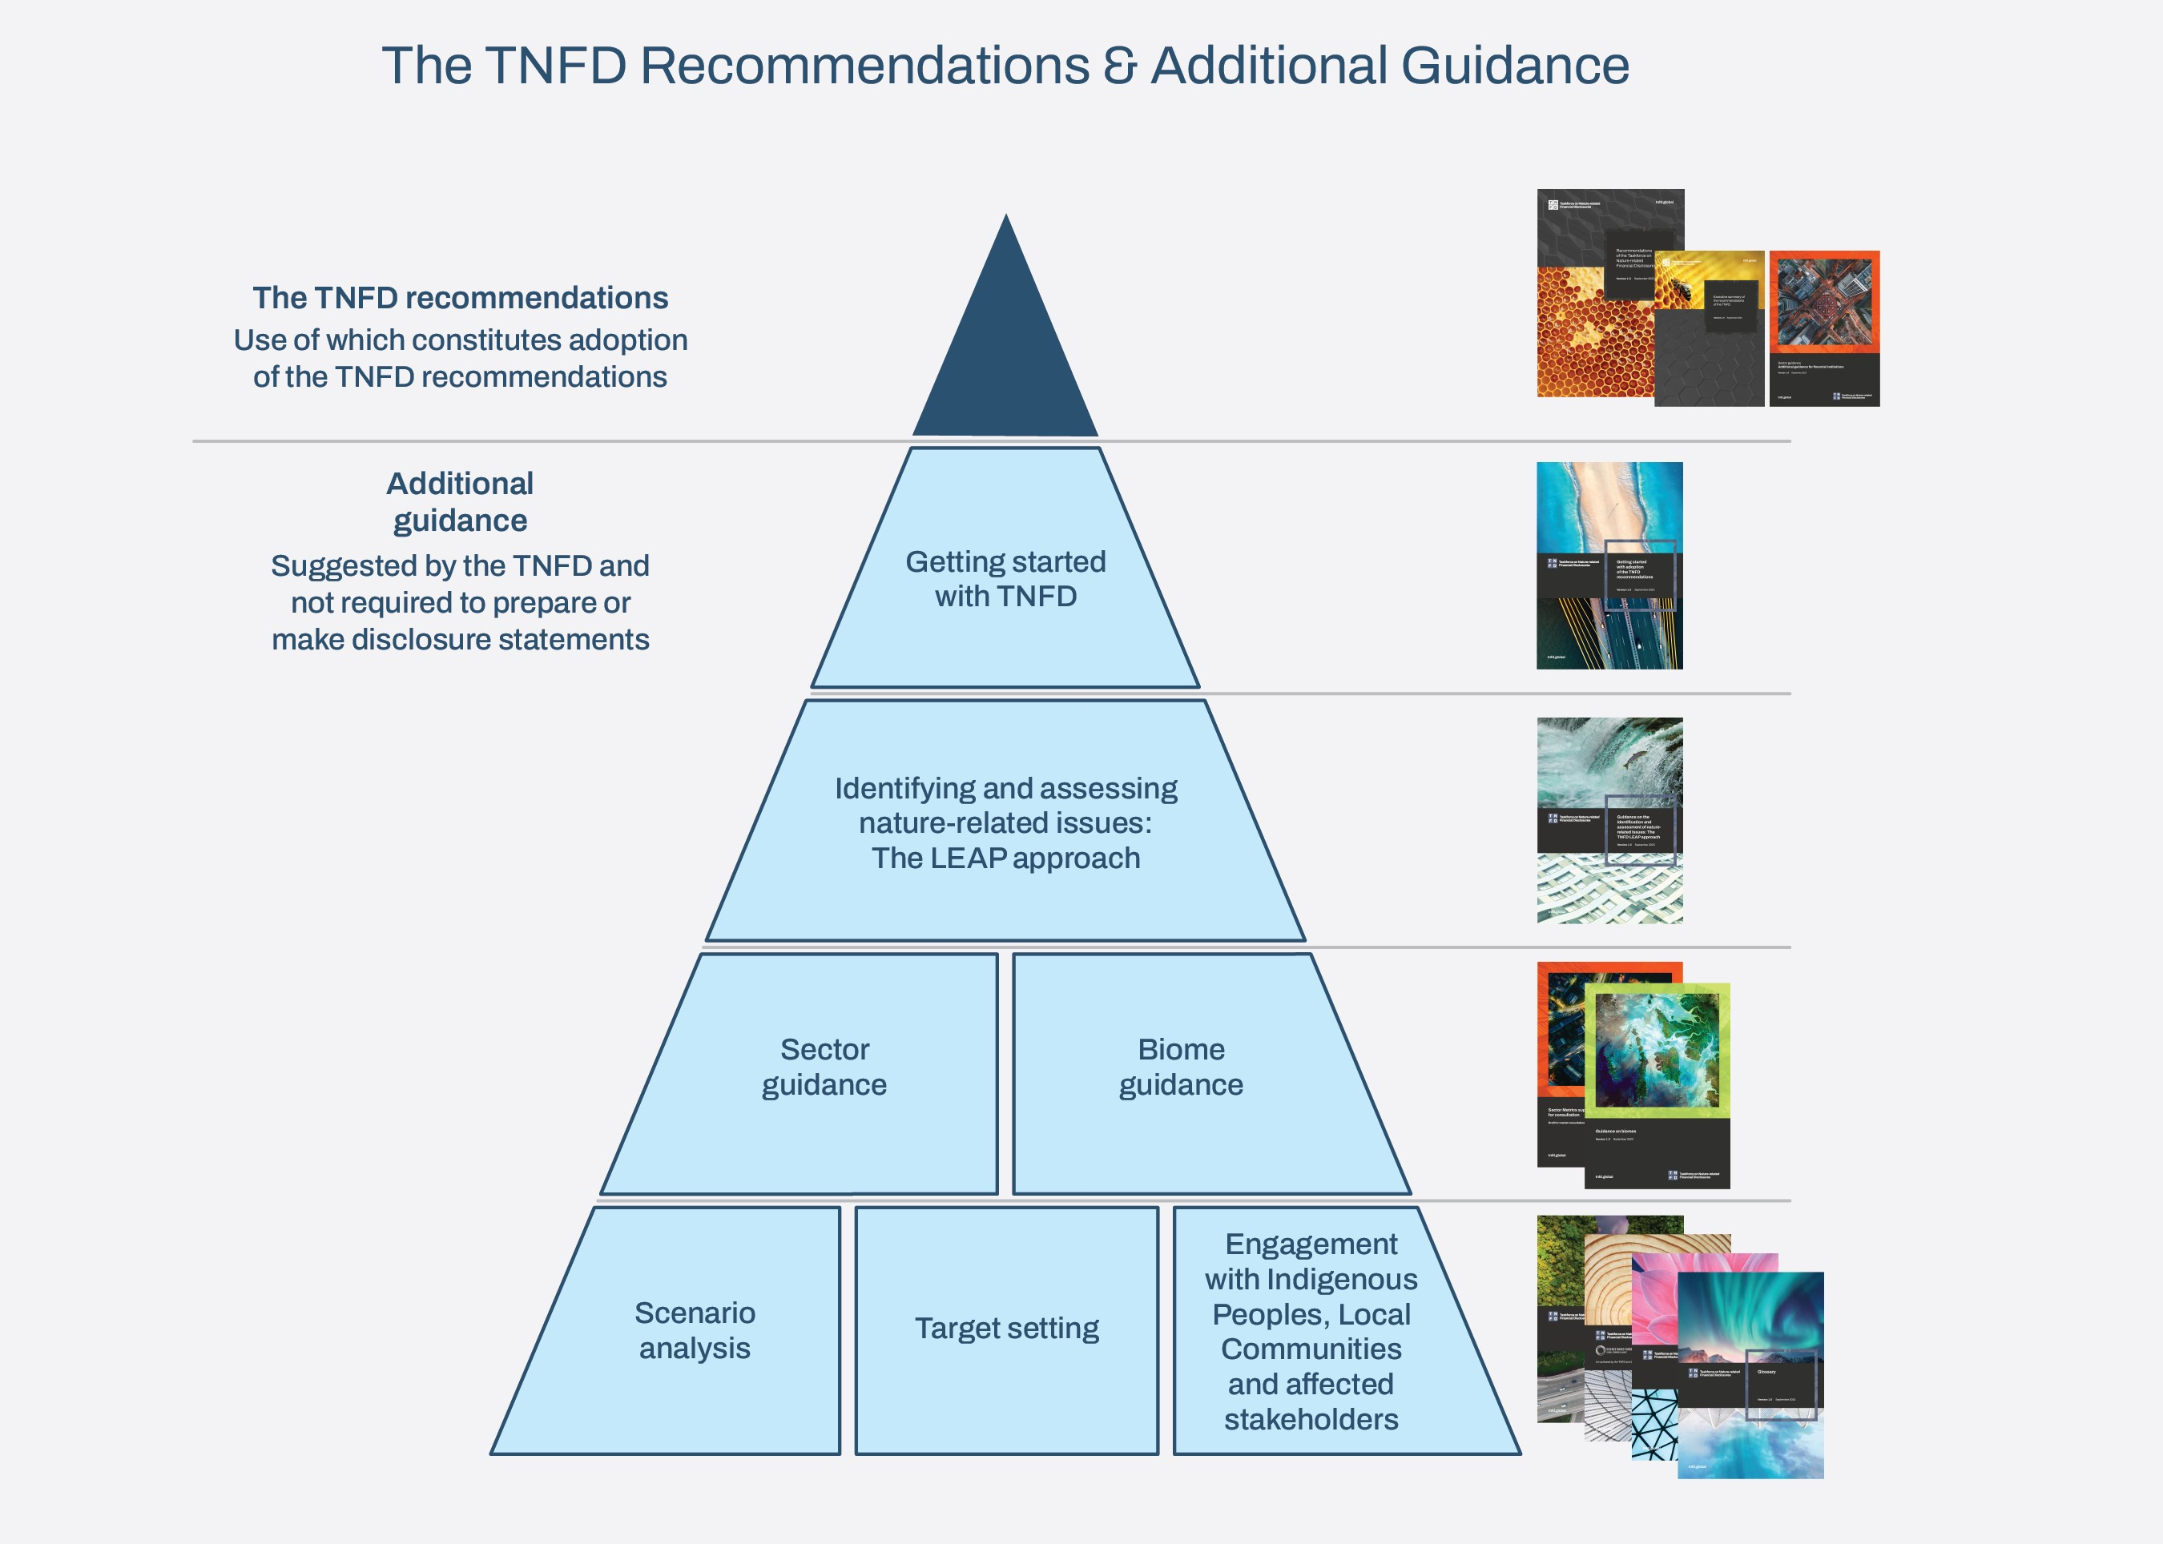
Practical Guidance: TNFD Resources
Fig.: TNFD recommendations and additional guidance. Source: Recommendations of the Taskforce on Nature-related Financial Disclosures, p.11.
Notes:
The initiative has published sector guidance for Engineering, construction and real estate, Construction materials, and Electric utilities and power generators, to address infrastructure specific reporting considerations.

Slide 19
IS Ratings & TNFD: Alignment Kerry Griffiths | IS Technical Director | ISC

Slide 20
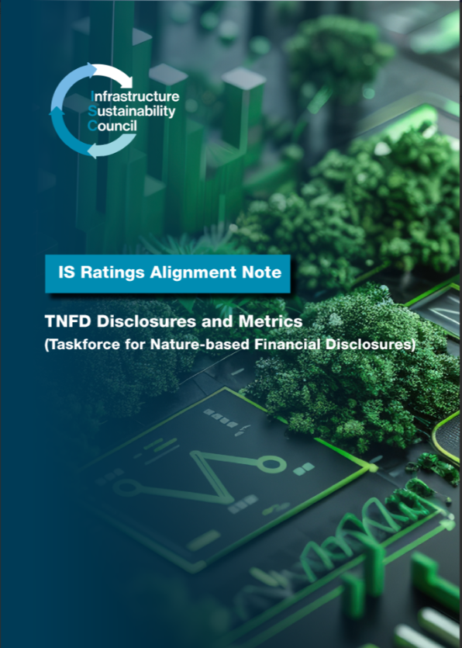
IS Ratings & TNFD Disclosures
The IS Rating Scheme offers a structured framework that can support reporting aligned with the TNFD recommended disclosures
IS Ratings can act as a comprehensive and verified data acquisition mechanism for disclosures and metrics required in TNFD reporting
IS Ratings allow for place-based reporting of an organisation’s material impact
IS Ratings determine and weigh materiality
IS Ratings provide real project data as opposed to industry averages and proxy data
IS Ratings Alignment Note – TNFD

Slide 21
TNFD & IS Ratings Alignment
Materiality
The TNFD framework accommodates two approaches to materiality, where there is no regulatory approach defined:
Financial Materiality Approach: material information needs of capital providers, consistent with the ISSB’s IFRS Standards and TCFD recommendations (recommended baseline);
and
Double Materiality Approach: material information needs of stakeholders focused on impacts, aligned with a broader materiality approach, consistent with the GRI Standards (optional).
The IS Ratings Scheme contains a compulsory Materiality Assessment that is aligned with the non-financial elements of lens 2. It identifies the most important (material) sustainability issues for each individual infrastructure project and program. It results in adjustments to weightings within the IS Rating tools to tailor and focus tool use to the specific project/asset stakeholders and context.
The Materiality Assessment in the IS Rating Scheme is recommended to be undertaken in collaboration with key stakeholders and is independently verified for each project or program.
Notes:
For example, if an asset uses significant energy in operation (e.g. a railway) and also in construction (e.g. due to earth moving and tunnelling) then ‘Energy and Carbon’ is likely to be an issue of high Materiality and therefore results in a higher weighting of the Energy and Carbon credits compared to less material issues. Similarly, where a project / asset is being built or operating in an ecologically sensitive area (e.g. providing species habitat) the ‘Ecology’ credits would be rated highly respectively.

Slide 22
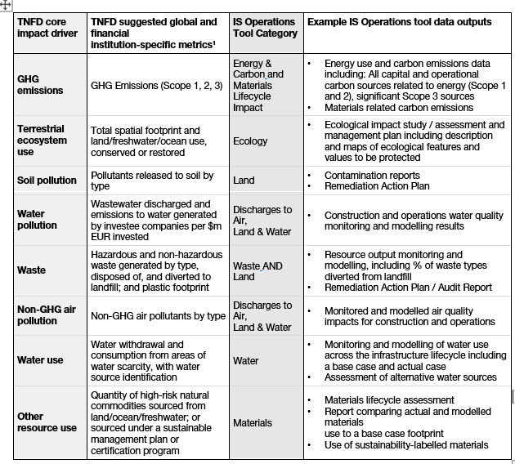
TNFD & IS Ratings Alignment
TNFD Metrics and targets
The IS Ratings Scheme is designed to capture asset level data and manage and verify impact of an asset during its full lifecycle. These asset level – and hence place-based - data can be aggregated and feed into the ESG report at the organisational level.
Example of TNFD core impact drivers and their correspondence with IS Operations rating data outputs, Source: IS Ratings Alignment Note, ISC.

Slide 23
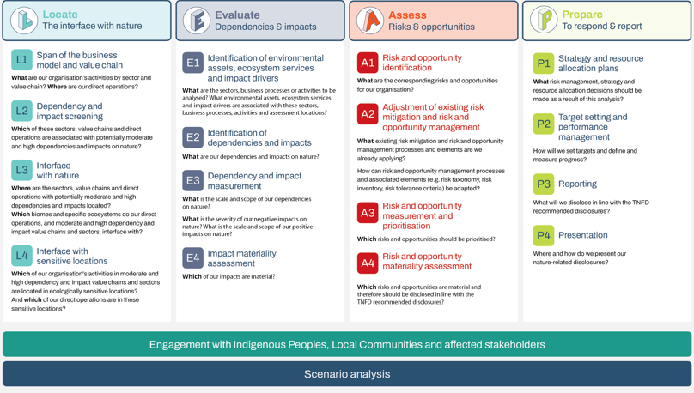
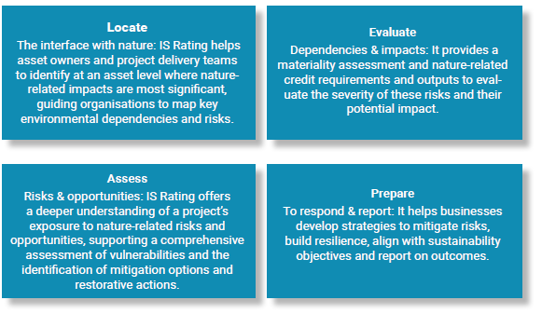
TNFD & IS Ratings Alignment
The IS Rating tools align well with the TNFD’s (optional) LEAP approach by applying a structured framework for nature-related disclosures and metrics at the project / asset level.
Fig.: The LEAP approach. Source: Guidance on the identification and assessment of nature-related Issues: The TNFD LEAP approach, p.4.
Fig.: The LEAP approach and IS Ratings. Source: : IS Ratings Alignment Note, ISC.
Notes:
Locate – the interface with nature: IS Rating helps asset owners and project delivery teams to identify at an asset level where nature-related impacts are most significant, guiding organisations to map key environmental dependencies and risks.
Evaluate – dependencies & impacts: It provides a materiality assessment and nature-related credit requirements and outputs to evaluate the severity of these risks and their potential impact.
Assess – risks & opportunities: IS Rating offers a deeper understanding of a project’s exposure to nature-related risks and opportunities, supporting a comprehensive assessment of vulnerabilities and the identification of mitigation options and restorative actions.
Prepare – to respond & report: It helps businesses develop strategies to mitigate risks, build resilience, align with sustainability objectives and report on outcomes.

Slide 24
TNFD & IS Ratings – For Noting
IS Ratings will not cover all elements of TNFD reporting
IS ratings will…
help identify, quantify and manage nature - related risks, and
assess those risks on a project/asset level, thereby enabling the place-based approach to disclosures.
Then …
Nature-related risks and opportunities need to be translated into financial risk/ opportunities, and
aggregated on an organisational level for reporting.
Notes:
Neither TNFD nor IS Ratings provide guidance on detailed methodologies for translating nature-related risk and opportunities into financial risk/ opportunities. However, the IS Rating does help identify, quantify and manage those risks. This data can be used as a basis for corporate ESG management and reporting.
The TNFD disclosures apply to an organisation as a whole / rather than a project. It is important to note that IS Ratings cover a part of an organisation’s nature-related impacts by assessing them at the infrastructure project and asset level – for the asset types listed above. Other nature-related impacts, risks and opportunities that a company is affected by would need to be captured separately

Slide 25
IS Ratings & TNFD: Correspondence Map Amin Niazai | Senior Technical Advisor | ISC

Slide 26
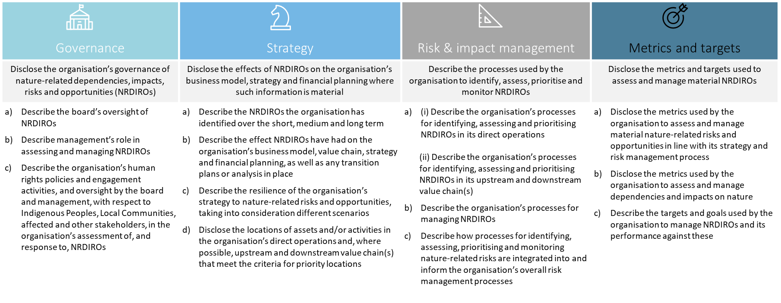
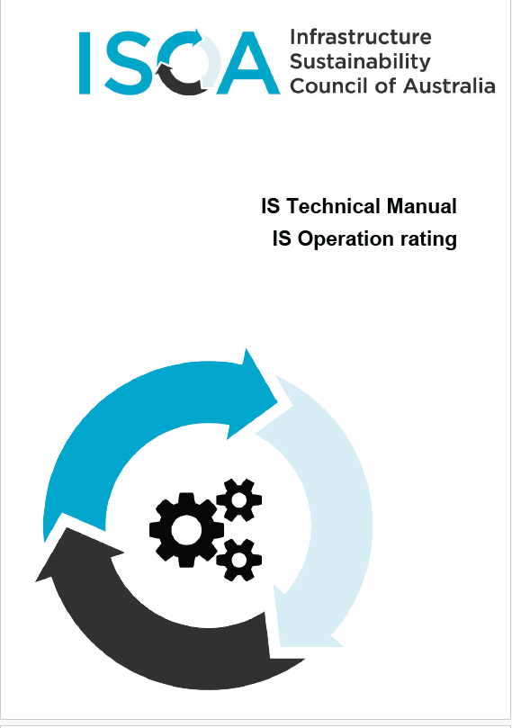
IS Ratings Alignment Note
We have mapped the credits in the IS Ratings Tools (D&AB V2.1 and Operations) against TNFD Disclosure Recommendations

Slide 27
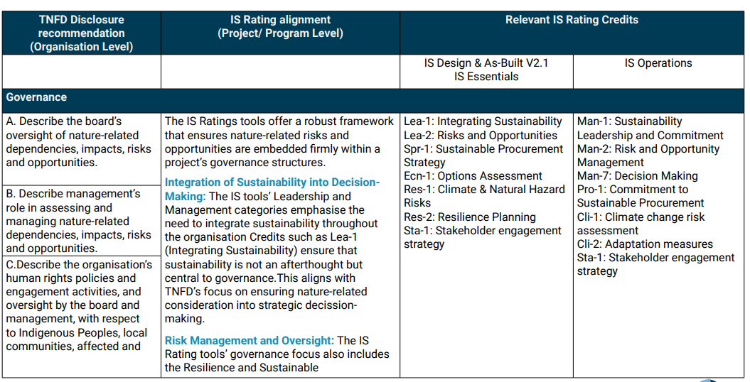
TNFD & IS Ratings: Correspondence Map
There is high overlap between the TNFD recommendations and IS Rating Tools, providing an opportunity for IS Ratings data and insights to be used to support more asset specific TNFD reporting.
Fig.: TNFD X IS Rating Correspondence map (excerpt). Source: : IS Ratings Alignment Note, ISC.

Slide 28
IS Ratings Alignment Note
Review the IS Ratings Alignment note for more detail:
IS Ratings Alignment Note – TNFD

Slide 29
Questions & Answers

Slide 30
Call out: Download Alignment note and let us know if you’re attempting TNFD

Slide 31
Thank you

